Slide 1
Strategic Marketing Simulator 1.0
Strategic Marketing Simulator 1.0
Team # 15
Team Members
Jeffrey Carman
Javier Andrial
Product Owner: Joseph Cilli
Project Mentor: Masoud Sadjadi

Slide 2
Introduction
Simulation of hotel sales market
Groups
Strategic Decisions
Accountability
Administration

Slide 3
Feasibility Study
Current System: Lecture and debate
Drawbacks:
Simulation restricted by class schedule
Results are possibly bias

Slide 4
Feasibility Study
Selection Criteria
Market affected by user decisions
Groups
Grading
Bots
Hotel specific market
Long periods

Slide 5
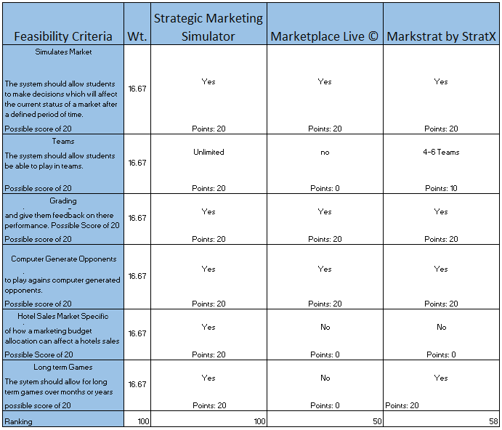
Feasibility Study - Matrix

Slide 6
Requirements – user stories
User Story # 666- Account Creation
Tasks
Insert database tables for users, groups, and courses (database subsystem).
Setup blank home page with login link.
Setup login page (username, password text boxes; “forgot my password”, “new user” links; and login button.
Setup account creation webpage (username, password, PID, email text boxes; and a list of courses available.
Setup PHP class user with getter/setter methods and boolean value for isAdmin.
Setup PHP Database class and methods for updating user and group tables of the database subsystem
write scripts to tie it all together

Slide 7
Requirements – user stories
User Story # 669- User login
Tasks
Add methods to PHP Database class for user login.
write scripts to communicate with to Database subsystem from front end.
write scripts to navigate user to homepage upon success.
Appropriate error message upon value.
(Future release should have account lockout policy)

Slide 8
Requirements
Functional Requirements
The System shall allow admin users to create a admin level user account.
The System shall allow Administrative and Student users to log in to the system
The System shall logout the user upon user request

Slide 9
Requirements
Scenarios
Scenario 1 - User Logs into the System
George, Navigates to the Strategic Marketing Simulator webpage. George is prompted with a Login Dialog box. George enters his FIU.edu email and his password for the System. George is taken to his Homepage and is now Successfully logged into the System.
Scenario 2 - Student creates an account in the system
A student in a FIU marketing course, George, is told by his professor to create an account in the System for tonight’s homework. George goes home from class and accesses the Strategic Marketing Simulator webpage. George does not have an account and selects ‘Create an Account’ on the login page. George enters in his FIU.edu email and is sent a confirmation email. George receives a confirmation email and is navigated back to the site where he fills out his personal information (full name and Username) and a password for his account. George was successfully able to create his Student user account and can now log into the System with his email and password.

Slide 10
Requirements – use case model
Use Case 2– User logs into the system
Actor: User
Pre-Conditions: User has an account
Normal Course:
1. User Enters username in text box
2. User Enters password in text box
3. User clicks Login
Alternative Course
Username or password was incorrect – repeat process
Account is not active – contact administrator

Slide 11
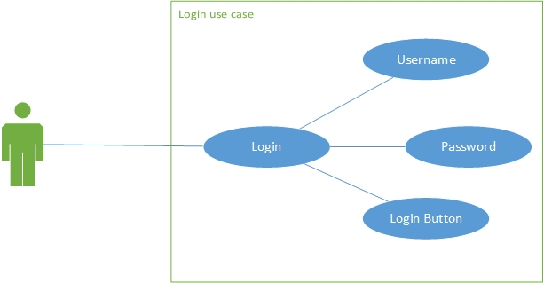
Requirements – use case model
User login use case

Slide 12
Requirements – use case model
Use Case 1 – User creates an account in the system
Actor: User
Pre-Conditions: User does not currently have an account
Normal Course:
1. User clicks create an account button
2. User fills out required information
3. An email is sent to Users preferred email
4. User receives the email and verifies that email
5. User click the link in email and is asked to enter a new password
Alternative Course
Email never received
Syntax Error Personal Information
Password is not valid

Slide 13
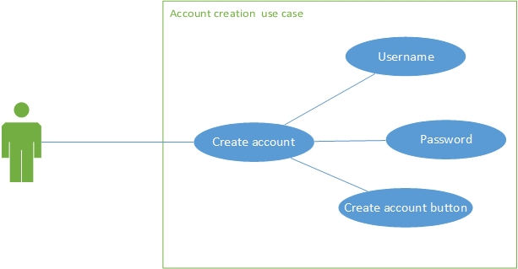
Requirements – use case model
Account Creation use case

Slide 14
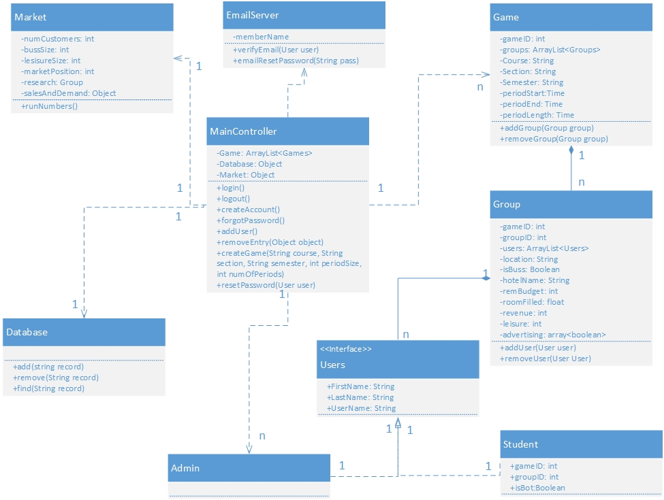
Design – Class Diagram

Slide 15
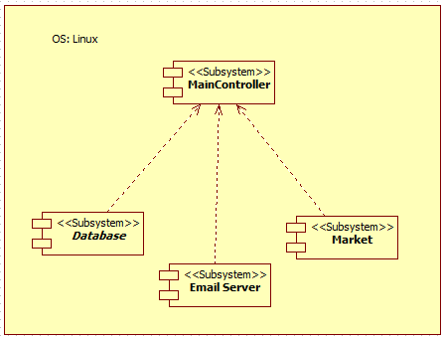
Design – Deployment diagram

Slide 16
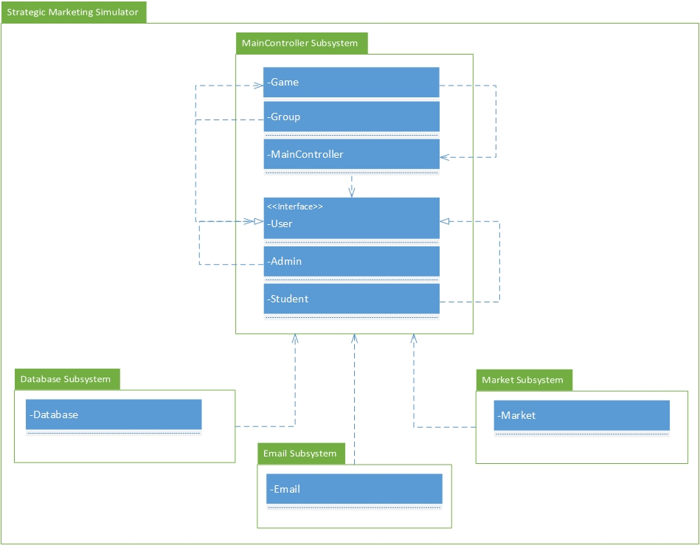
Design – Package Diagram

Slide 17
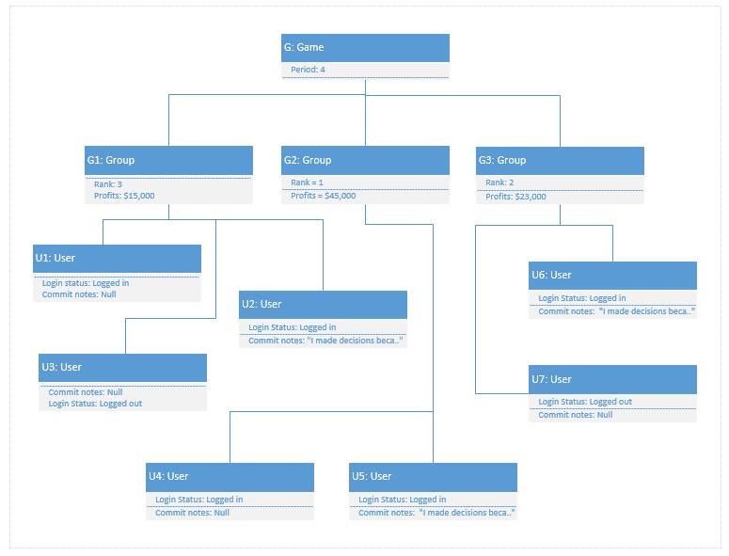
Design – Object Diagram

Slide 18
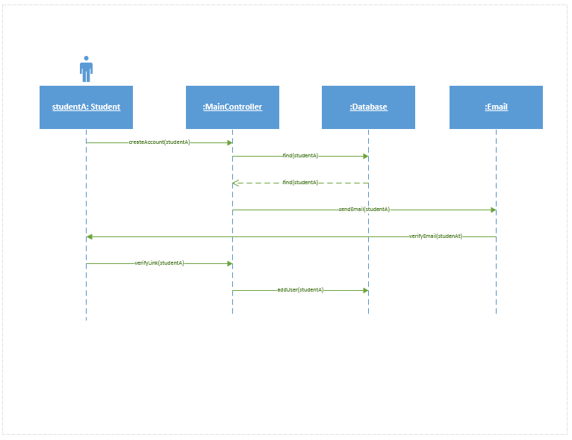
Design – Account creation sequence diagram

Slide 19
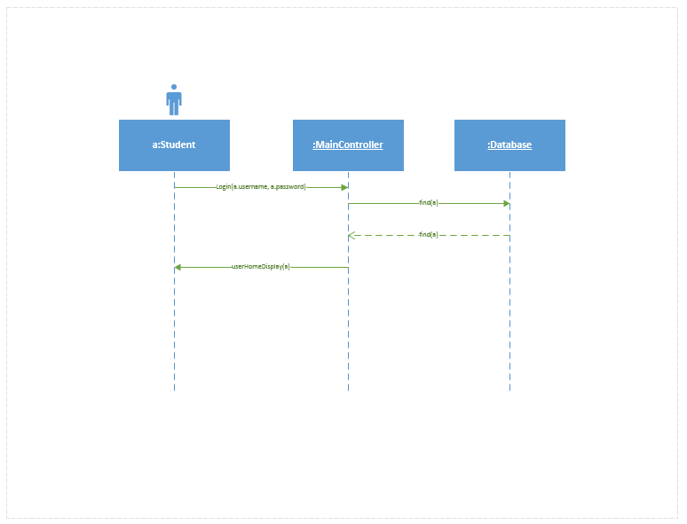
Design – User Login sequence diagram

Slide 20
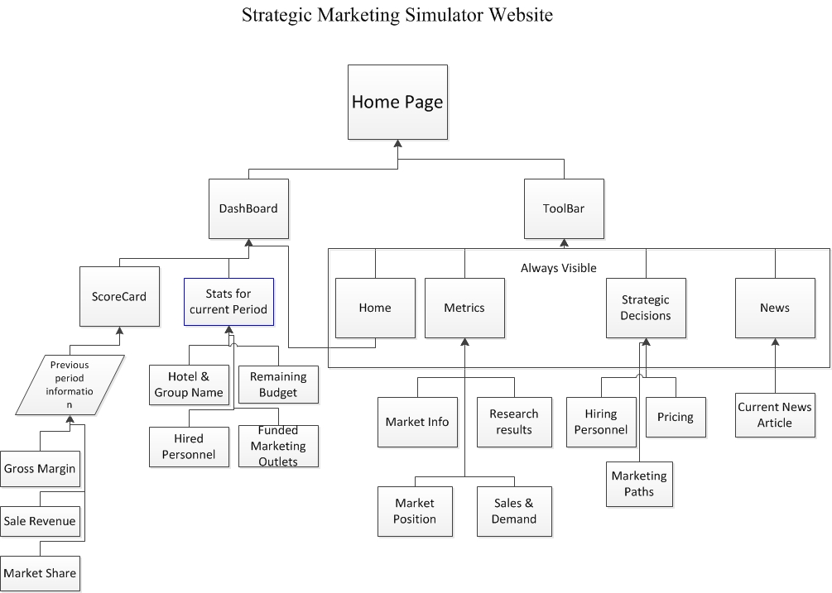
Website flow

Slide 21
Website Mockup
..\Downloads\Senior Project docs\MockUps\WebSite\Senior Project Marketing website mockup.pdf
marketsim-dev.cis.fiu.edu

Slide 22
Design plan

Slide 23
Design plan actual
Aug 26 – Assigned A Project
Aug 27 – Meet with Joe
Aug 28 – Iron out ideas, worked on the website’s flow chart
Aug 29 – Created website mockup
Aug 30 – Started working on Documentation
Sept 1 – Sept 3 - Work on mingle cards
Sept 2 - VM Created
Sept 2 -Sept 10 – Setup work environment on VM
Aug 30 – Sept 10– Continue working on documentation
Sept 10 – Set up development environment and LAMP

Slide 24
Strategic Marketing Simulator 1.0
Problems which delayed the project:
Miscommunication with the project mentor regarding documentation
Setting up development environment.

Slide 25
Strategic Marketing Simulator 1.0
Questions?

